Slide 1
Git and GitHub
Pranay Shahare

Slide 2
Version Control Systems
Why do we need version control systems/software?
Many developers, a single (integrated) code, configuration files, database scripts, etc
Simultaneous changes done for bug fixing
Local copies maintained by each developer
Overwriting each other’s changes
Unauthorized changes to the code
Maintaining different code bases
Need for reverting to an older version of the software
Imagine that there are two developers who are developing code on an application server

Slide 3
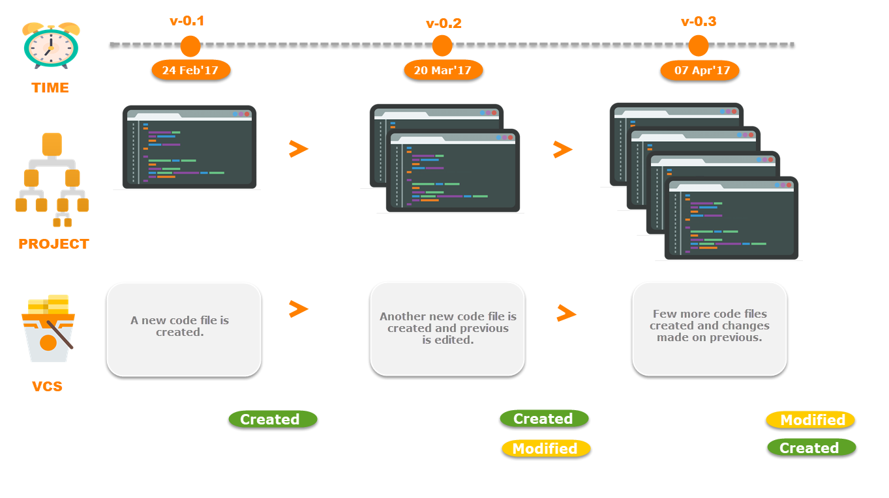
Git – A Version Control System

Slide 4
Different Developers Working on the Same Code on their Local Copies
Developer 1
…
…
…
Developer 2
…
…
…
Whose code should be considered as final?

Slide 5
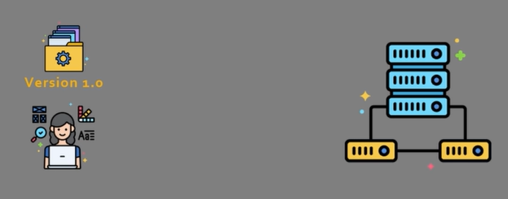
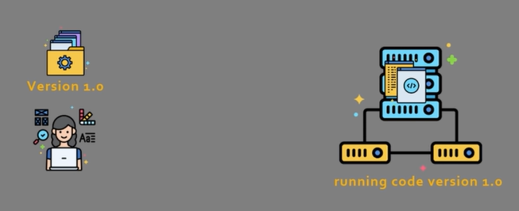
Version control example
Developer 1 wants to push version 1.0 of the code to an application server
After the push, the server runs code version 1.0

Slide 6
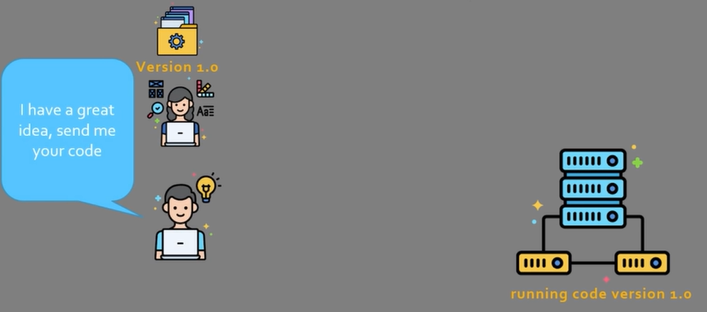
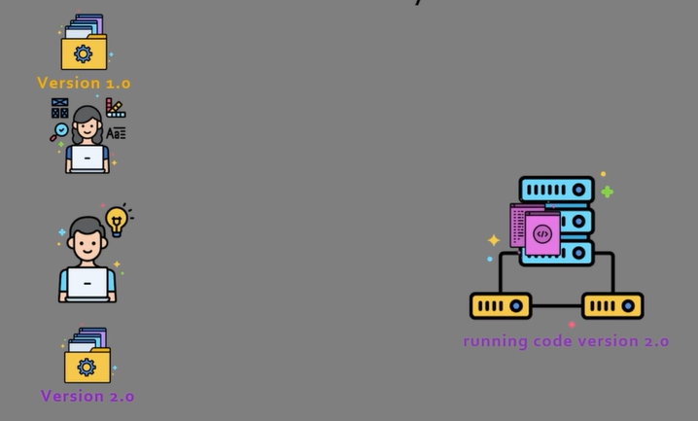
Version control example
Now a team member asks for her code
This team member has a folder called Version 2.0 and has deployed this version of the code on the server

Slide 7
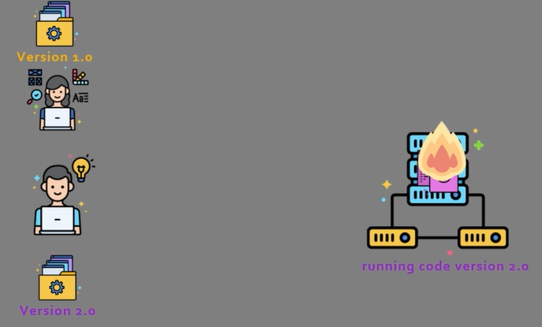
Version control example
Unfortunately, his code was not properly tested, and hence, crashes
Rolling back to version 1.0 is not easy – it is all mixed up

Slide 8
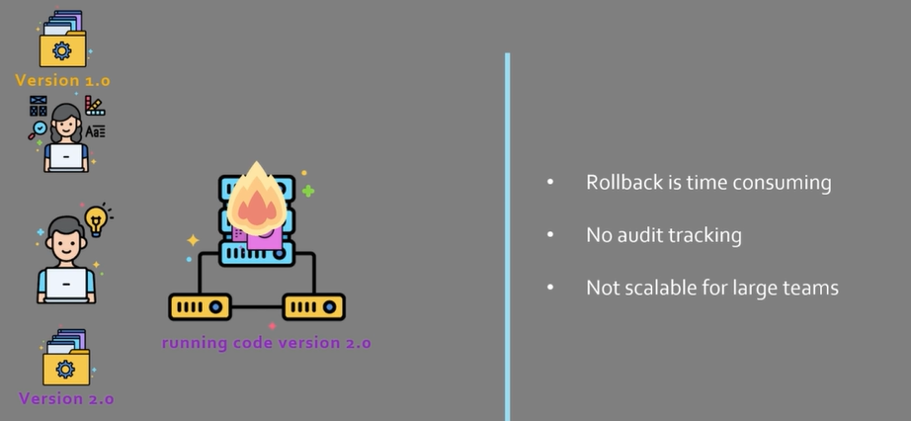
Problem summary

Slide 9
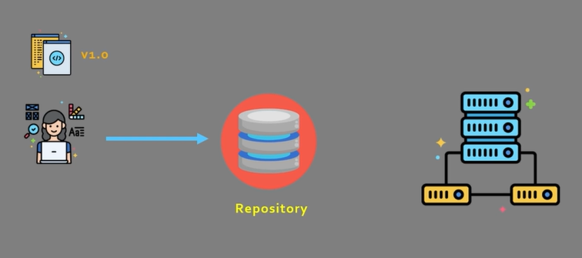
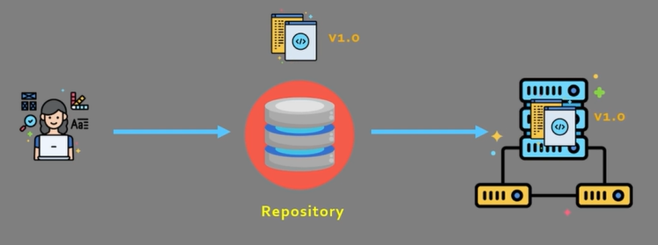
Version Control System and Repository
Developers now push the code to a repository
Code will be deployed from the repository

Slide 10
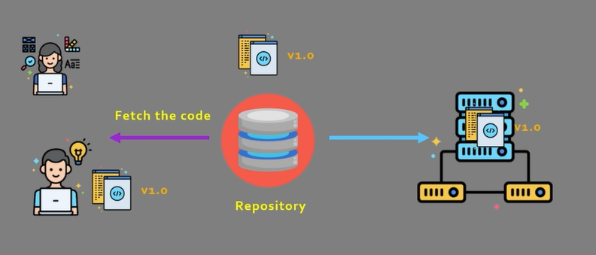
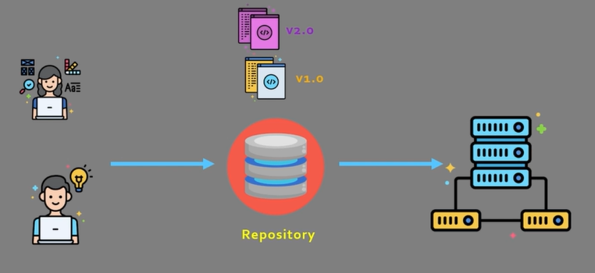
If another team member wants the code …
Fetch
Modify and push

Slide 11
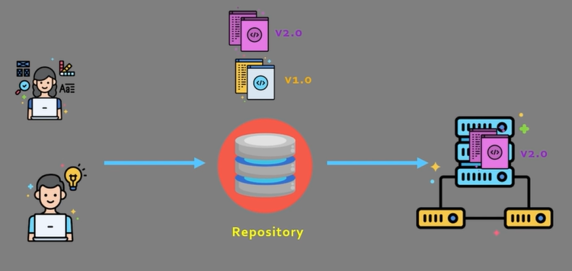
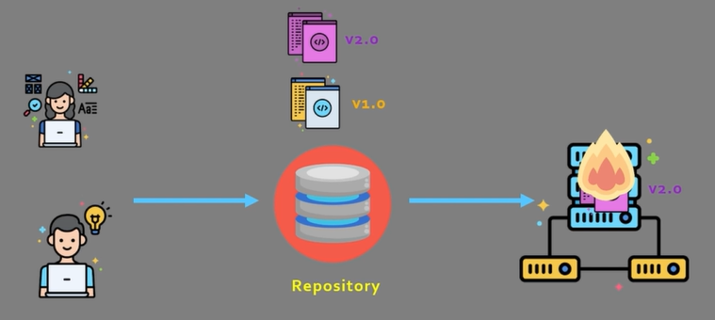
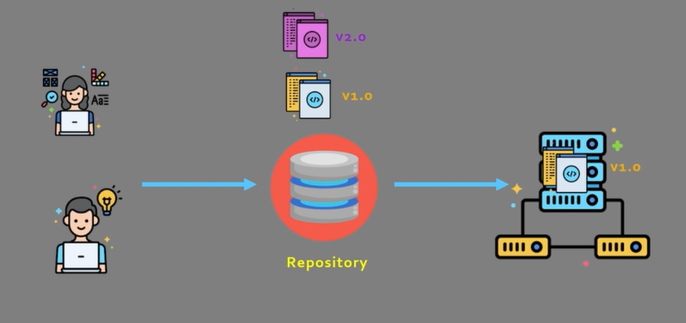
Deploy the new version
Deployed
Problems? Go back to version 1

Slide 12
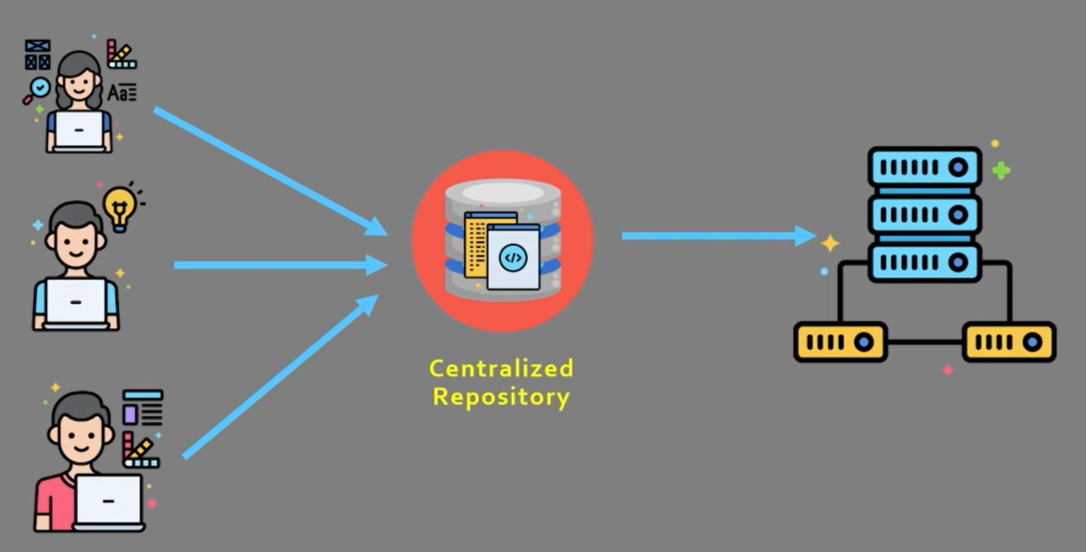
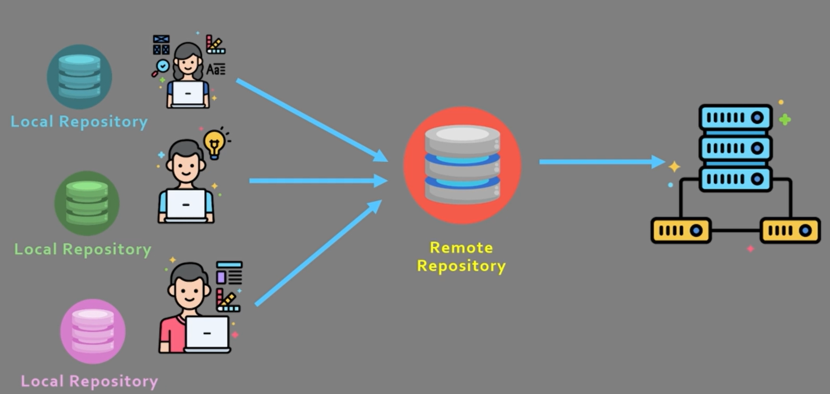
Types of Version Control System
Centralized
Each user has a local copy, but there is one central repository
Single point of failure
Requires constant connectivity
e.g. Subversion, Endevor
Distributed
Distributed
Each developer has a local copy and a separate repository, so loss of connection is manageable
More scalable
e.g. Mercurial, Git

Slide 13
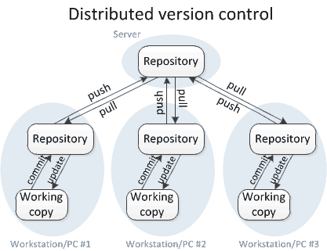
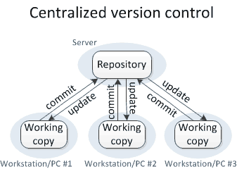
Centralized versus Distributed Version Control
For others to see your changes, 2 things must happen:
You commit
They update
For others to see your changes, 4 things must happen:
You commit and push
They pull and update

Slide 14
Commands and their Meaning
Commit and update commands: Only move changes between the working copy and the local repository, without affecting any other repository.
Push and pull commands: Move changes between the local repository and the central repository, without affecting your working copy.

Slide 15
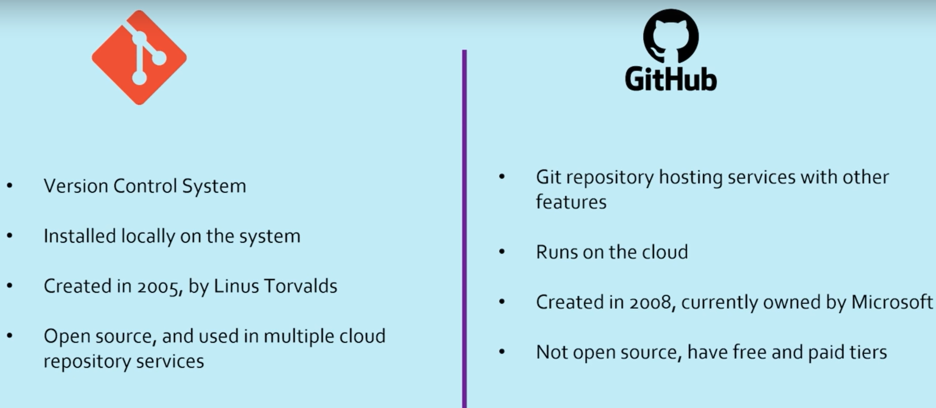
Git is not GitHub
Git

Slide 16
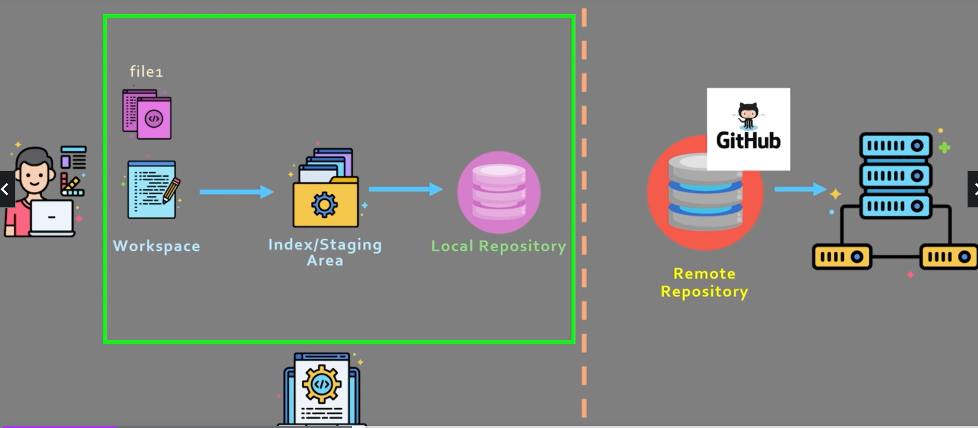
Git Workflow – 1

Slide 17
Git Workflow – 2
There are 3 distinct parts
Workspace – Area where the user is working and creating/modifying code
Index/Staging area – Area that closely mimics the local repository
Local repository – The local area for all the code
How this works? – Next slide

Slide 18
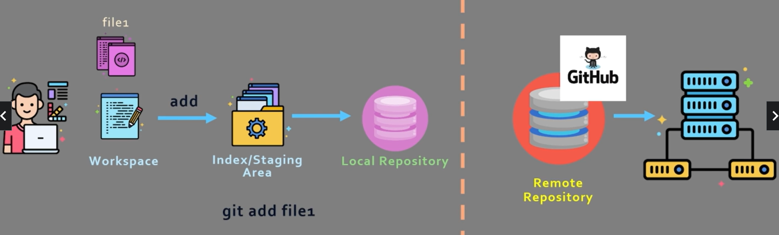
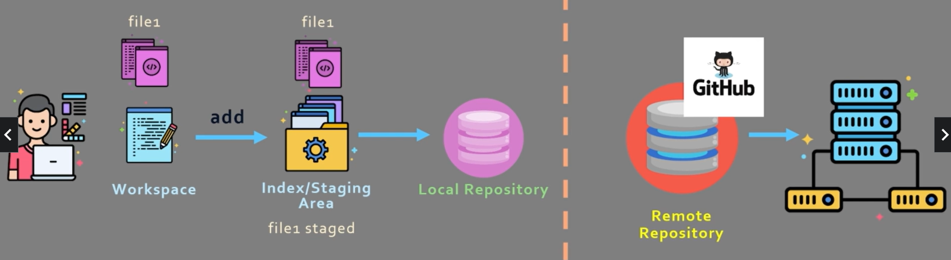
Git Workflow – 3
When user says git add file1, it will get added to the staging area

Slide 19
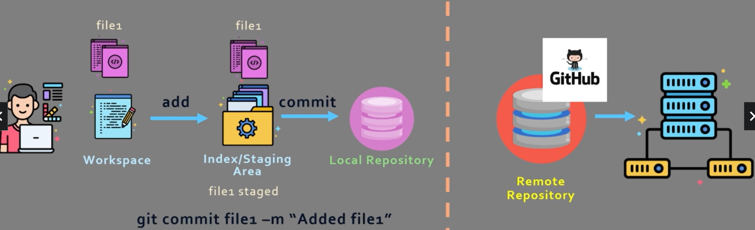
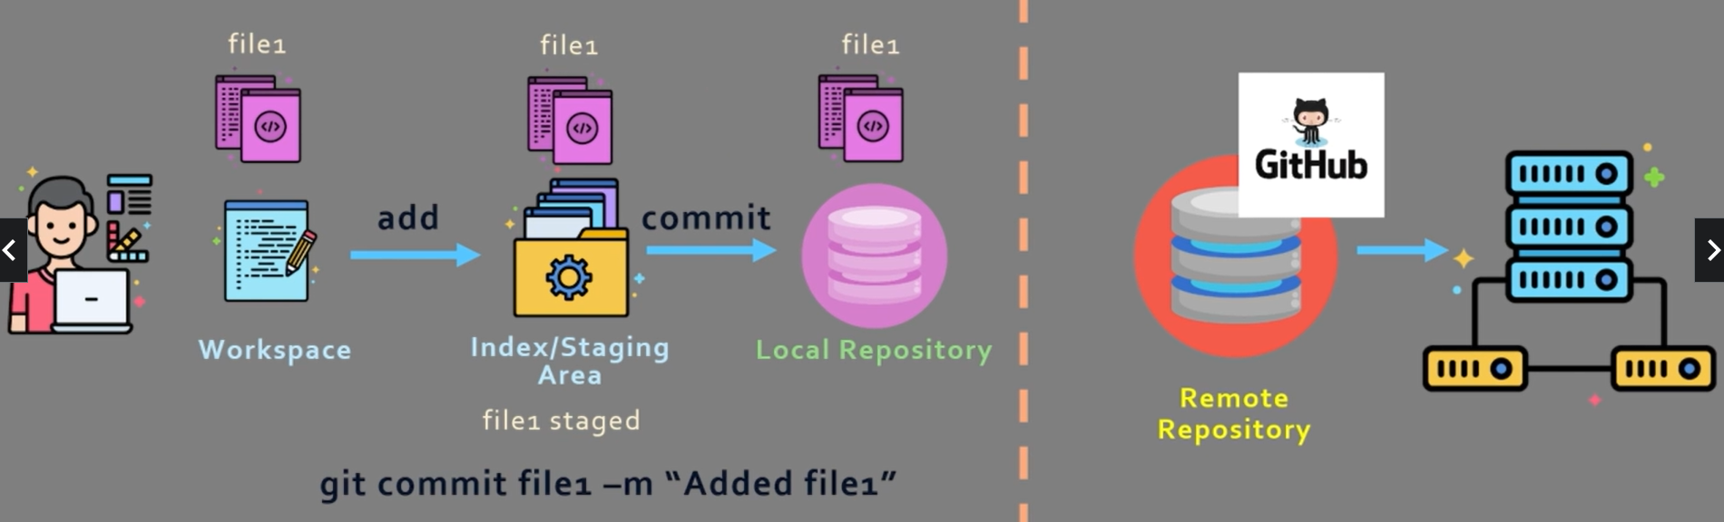
Git Workflow – 4
When user says git commit file1 –m “Added file1”, it will get added to the local repository

Slide 20
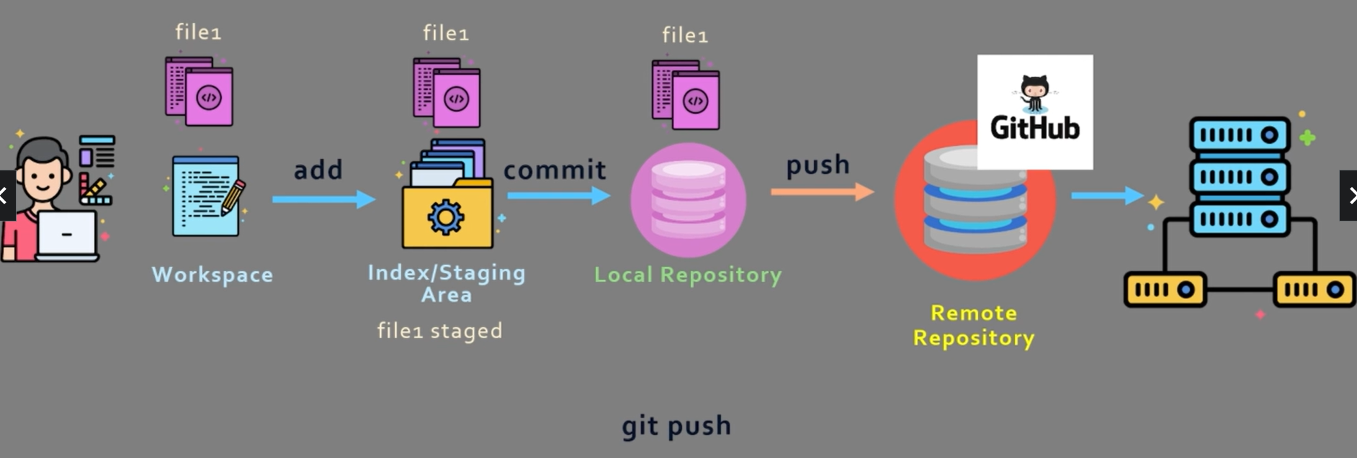
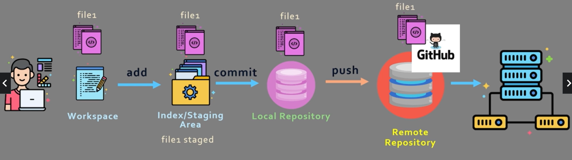
Git Workflow – 5
When user says git push, the changes will go to the remote repository

Slide 21
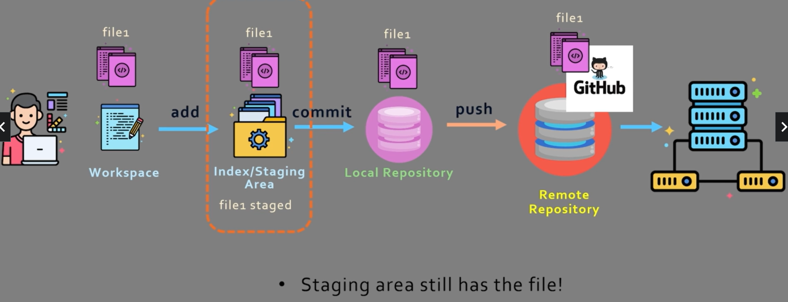
Git Workflow – 6
Important point

Slide 22
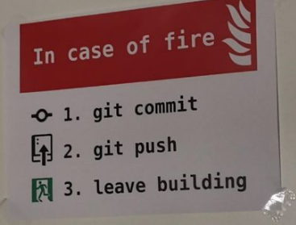
Some Fun!

Slide 23
Git Setup

Slide 24
Download and Setup
Download git and install
git config --global user.name “pranayshahare26”
git config --global user.email “pranayshahare31@gmail.com”
Visit github.com and signup using the above email id

Slide 25
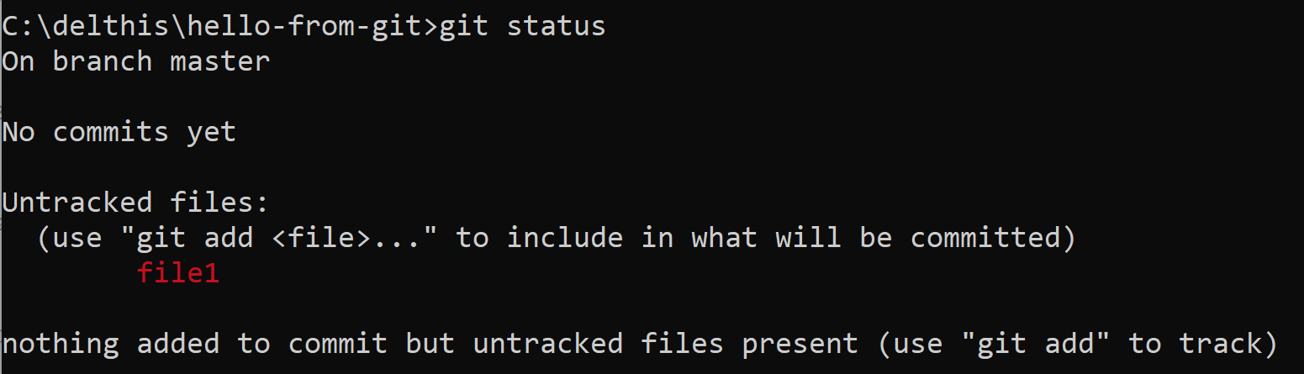
Using git
Create a directory hello-from-git somewhere on the local drive (e.g. C:\delthis\hello-from-git)
To enable tracking of this folder by git, in the folder, run git init
Create file1.txt in this folder in some text editor (e.g. C:\delthis\hello-from-git\file1)
Type Hello World from Git in the file and save it
On the command prompt, type git status

Slide 26
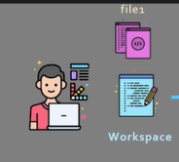
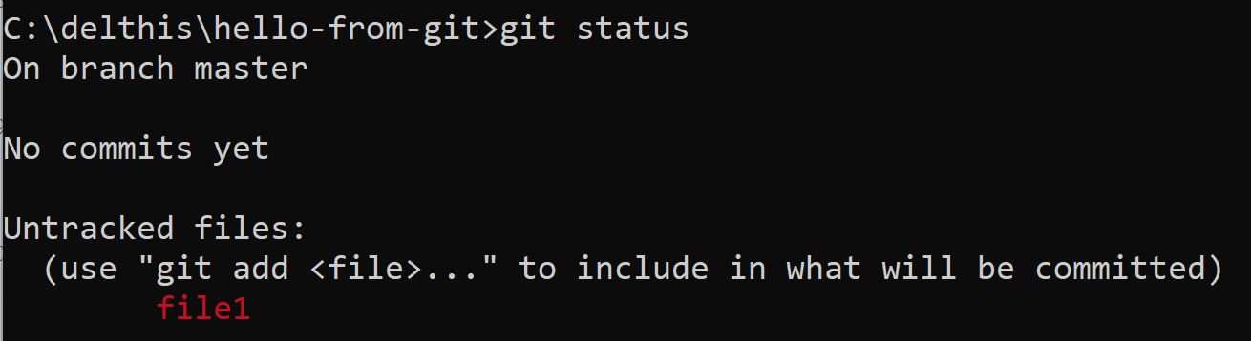
Using git
What does this mean? It means that file1 is in the Workspace

Slide 27
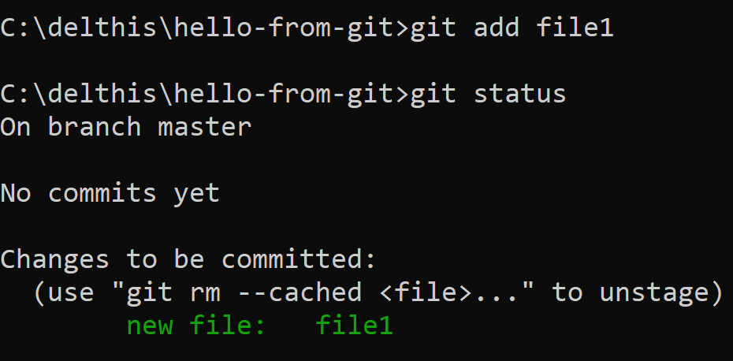
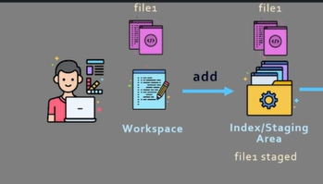
Adding the file to the Index/Staging Area
git add file1

Slide 28
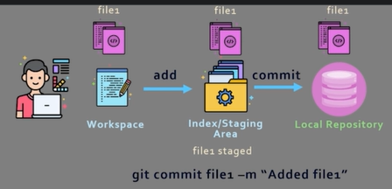
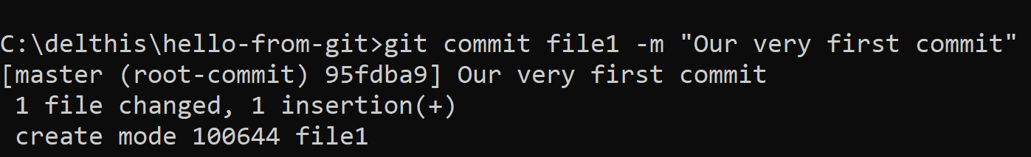
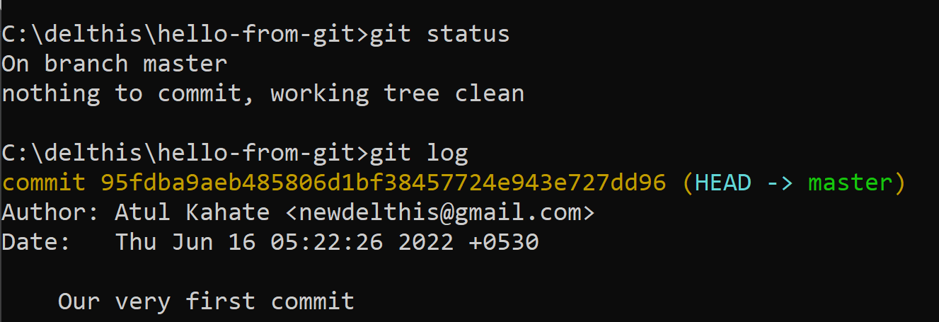
Committing the file to the Local Repository
git commit file1 –m “Our very first commit”
git status and git log

Slide 29
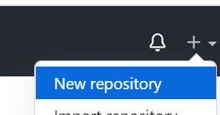

Pushing the file to Github – 1
Go to github and click on New repository
Leave the other defaults and Create repository
Copy the last three commands shown on the next page:
git branch -M main
git remote add origin https://github.com/newdelthis/hello-from-git.git
git push -u origin main

Slide 30
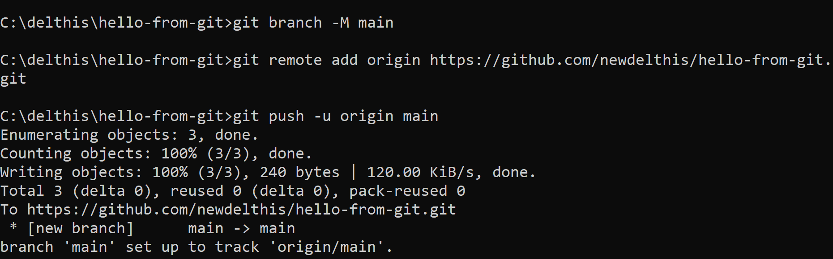
Pushing the file to Github – 2
Paste the three commands on the command prompt and press enter

Slide 31
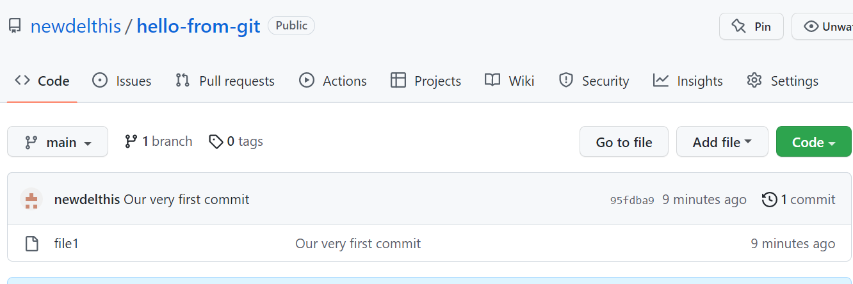
Pushing the file to Github – 3
Verify the repository on the github page by refreshing it

Slide 32
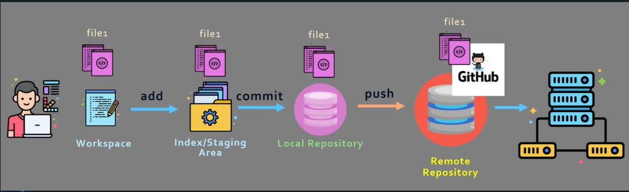
Pushing the file to Github – 4
End result

Slide 33
If you get Authentication Error …
GitHub now expects us to use SSH instead of HTTP/HTTPS
We need to create an SSH public and private key pair and use this keypair to log in to GitHub using SSH
Steps to follow on the next slide …

Slide 34
Create a SSH Key-Pair
ssh-keygen -t rsa -b 4096 -C " Your email id" on the command prompt
Do not give any passphrase (See next slide)
It will generate a key pair and the public key will be stored in C:\Users\akaha/.ssh/ id_rsa.pub (public key) and C:\Users\akaha/.ssh/ id_rsa (private key) file
Open the file in an editor, copy the full contents of the public key file
Github -> SSH and GPG Keys -> SSH Keys -> New SSH Key -> Give a name in Title and paste the key in Key

Slide 35
Test the SSH Key
ssh -T git@github.com
Now try adding a file and pushing to GitHub
git add –A
git commit -am “ Comment“
git branch -M main
git remote add origin git@github.com:newdelthis/test.git
git push -u origin main

